Slide 1






EF Advanced Querying
Optimize Performance
Advanced
Querying
SoftUni Team
Technical Trainers
Software University
http://softuni.bg

Slide 2


Table of Contents
Native SQL Queries
Object State
Batch Operations
Stored Procedures
Types of Loading
Concurrency
Cascade Operations

Slide 3
Questions
sli.do #Entity

Slide 4
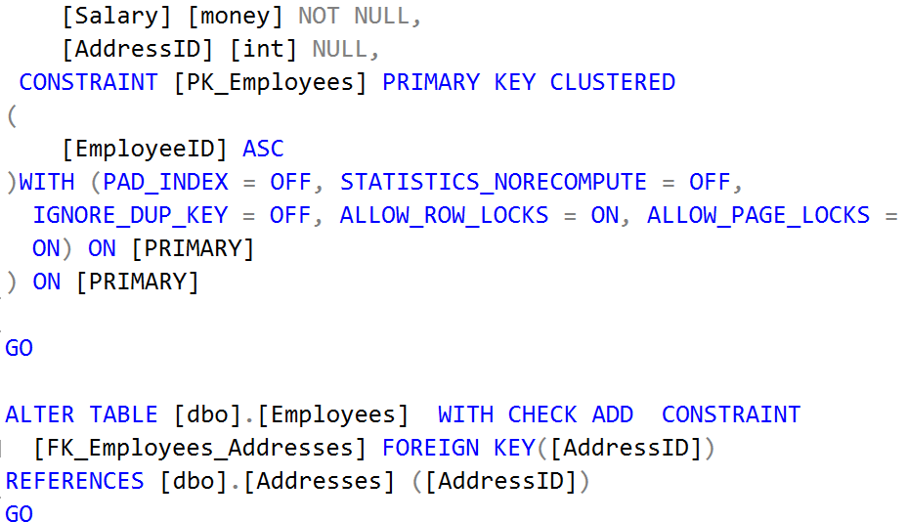
Executing Native SQL Queries
Parameterless and Parameterized

Slide 5
Executing Native SQL Queries
Executing a native SQL query in Entity Framework directly in its database store:
Example:
ctx.Database.SqlQuery<return-type>(native-SQL-query);
string query = "SELECT count(*) FROM dbo.Employees";
var queryResult = ctx.Database.SqlQuery<int>(query);
int customersCount = queryResult.FirstOrDefault();

Slide 6
Native SQL Queries with Parameters
Native SQL queries can also be parameterized:
var context = new SoftUniEntities();
string nativeSQLQuery =
"SELECT FirstName + ' ' + LastName " +
"FROM dbo.Employees WHERE JobTitle = {0}";
var employees = context.Database.SqlQuery<string>(
nativeSQLQuery, "Marketing Specialist");
foreach (var emp in employees)
{
Console.WriteLine(emp);
}
Parameter placeholder
Parameter value

Slide 7
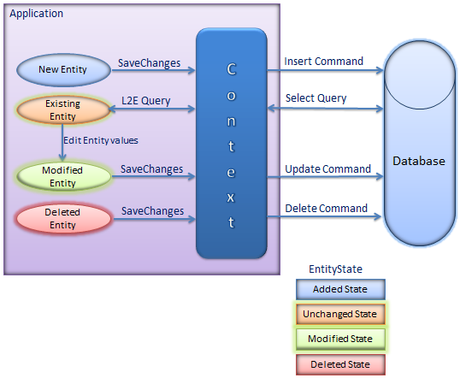
Object State Tracking

Slide 8
Attaching and Detaching Objects
In Entity Framework, objects can be:
Attached to the object context (tracked object)
Detached from an object context (untracked object)
Attached objects are tracked and managed by the DbContext
SaveChanges() persists all changes in DB
Detached objects are not referenced by the DbContext
Behave like a normal objects, which are not related to EF

Slide 9
Attaching Detached Objects
When a query is executed inside an DbContext, the returned objects are automatically attached to it
When a context is destroyed, all objects in it are automatically detached
E.g. in Web applications between the requests
You might later on attach to a new context objects that have been previously detached

Slide 10
Detaching Objects
When an object is detached?
When we get the object from a DbContext and then Dispose it
Manually: by set the EntryState to Detached
Employee GetEmployeeById(int id)
{
using (var softUniEntities = new SoftUniEntities())
{
return softUniEntities.Employees
.First(p => p.EmployeeID == id);
}
}
Now the returned employee is detached

Slide 11
Attaching Objects
When we want to update a detached object we need to reattach it and then update it: change to Attached state
void UpdateName(Employee employee, string newName)
{
using (var softUniEntities = new SoftUniEntities())
{
var entry = softUniEntities.Entry(employee);
entry.State = EntityState.Added;
employee.FirstName = newName;
softUniEntities.SaveChanges();
}
}

Slide 12
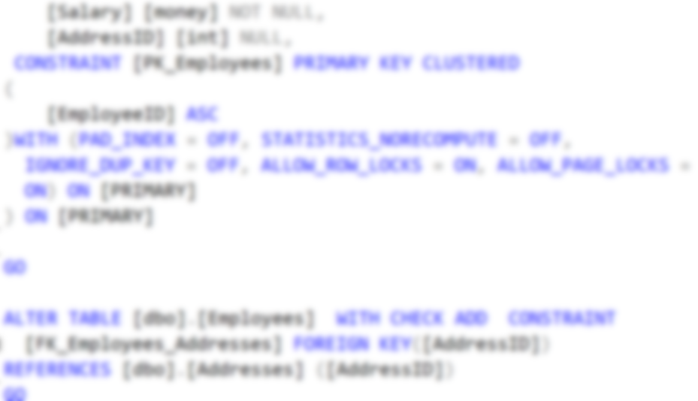
Batch Operations
Update
Update
Batch
Query
Update
Update
Multiple Update and Delete in Single Query

Slide 13
EntityFramework.Extended
Entity Framework does not support batch operations
EF.Extended gives you the ability to perform bulk deletion of rows/entities by given criteria.
Install EF.Extended as a NuGet package or simply run Install-Package EntityFramework.Extended
Notes:
https://weblogs.asp.net/pwelter34/entity-framework-batch-update-and-future-queries

Slide 14
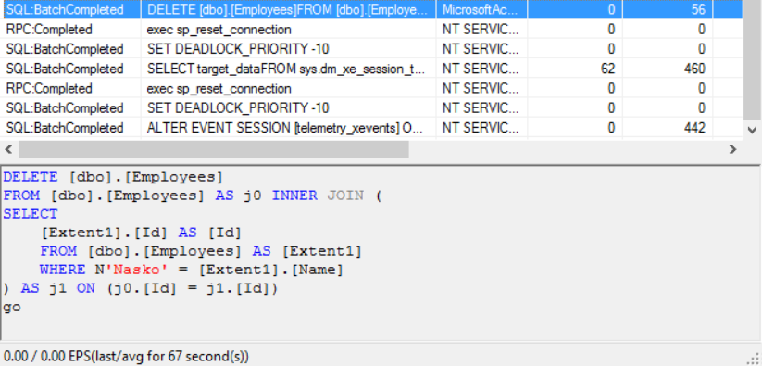
Bulk Delete
Delete all users where FirstName matches given string
context.Users.Delete(u => u.FirstName == “Pesho");

Slide 15
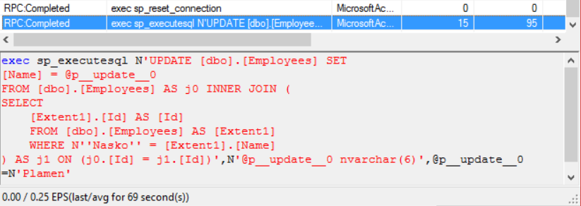
Bulk Update Without Prefilter
Update all Employees with Name “Nasko” to “Plamen”
context.Employees.Update(
t => t.Name == "Nasko",
t => new Employee() {Name = "Plamen"});

Slide 16
Bulk update with prefilter:
Update all Employees’ age to 99 who have a name “Plamen”
IQueryable<Employee> employees = context.Employees
.Where(employee => employee.Name == "Plamen");
context.Employees.Update(
employees,
employee => new Employee() {Age = 99});

Slide 17
Stored Procedures

Slide 18
Executing a Stored Procedure
Stored Procedures can be executed via SQL
Example:
SqlParameter ageParameter = new SqlParameter("@age", SqlDbType.Int);
ageParameter.Value = 2;
context.Database.ExecuteSqlCommand(
"UpdateAge @age", ageParameter);
CREATE PROCEDURE UpdateAge @param int
AS
BEGIN
UPDATE Employees SET Age = Age + @param;
END
Notes:
More information on how tom make stored procedures for Insert, update and delete - https://msdn.microsoft.com/en-us/library/dn468673(v=vs.113).aspx

Slide 19
Types of Loading
Lazy, Eager and Explicit Loading

Slide 20
Eager Loading
Eager loading means to load all related records of an entity
Performed with the Include method
The Include with the lambdas is found in the System.Data.Entity
context.Towns.Include("Employees");
context.Towns.Include(town => town.Employees);

Slide 21
Lazy Loading
Lazy Loading delays loading of data until it is used
Active by default, can be turned off via configuration
Required when serializing
Might be better in certain cases
public CompanyContext()
: base("name=CompanyContext")
{
Configuration.LazyLoadingEnabled = false;
}

Slide 22
Explicit Loading
You can explicitly force EF to load the data
Local cache can be accessed without sending a query
context.Entry(blog)
.Collection(b => b.Posts)
.Query()
.Where(p => p.Tags.Contains("entity-framework")
.Load();
var localPosts = context.Posts.Local;
localPosts.Add(new Post { Name = "What's New in EF" });
localPosts.Remove(context.Posts.Find(1));

Slide 23




Concurrency Checks

Slide 24
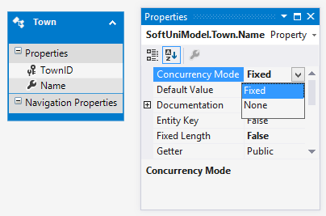
Optimistic Concurrency Control in EF
EF runs in optimistic concurrency mode (no locking)
By default the conflict resolution strategy in EF is "last wins"
The last change overwrites all previous concurrent changes
Enabling "first wins" strategy for certain property in EF:
ConcurrencyMode=Fixed (in DB first project)
[ConcurrencyCheck] (in code first projects)

Slide 25
Last Wins – Example
var contextFirst = new SoftUniEntities();
var lastProjectFirstUser = contextFirst.Projects
.OrderByDescending(p => p.ProjectID).First();
lastProjectFirstUser.Name = "Changed by the First User";
// The second user changes the same record
var contextSecondUser = new SoftUniEntities();
var lastProjectSecond = contextSecondUser.Projects
.OrderByDescending(p => p.ProjectID).First();
lastProjectSecond.Name = "Changed by the Second User";
// Conflicting changes: last wins
contextFirst.SaveChanges();
contextSecondUser.SaveChanges();
Last wins: the second user overwrites the first user's changes

Slide 26
First Wins – Example
var contextFirst = new SoftUniEntities();
var lastTownFirstUser = contextFirst
.Towns.OrderByDescending(
t => t.TownID).First();
lastTownFirstUser.Name = "First User";
var contextSecondUser = new SoftUniEntities();
var lastTownSecondUser = contextSecondUser.Towns
.OrderByDescending(t => t.TownID).First();
lastTownSecondUser.Name = "Second User";
contextFirst.SaveChanges();
contextSecondUser.SaveChanges();
First wins: the second user gets DbUpdateConcurrencyException

Slide 27
Cascade Operations
Client
Order
OrderProducts

Slide 28
Cascade delete scenarios
Required FK with cascade delete set to true, deletes everything related to the deleted property
Required FK with cascade delete set to false, throws exception (it cannot leave the navigational property with no value)
Optional FK with cascade delete set to true, deletes everything related to the deleted property.
Optional FK with cascade delete set to false, sets the value of the FK to NULL

Slide 29
Solving Cascade Delete Issue with Fluent API
Two solutions with Fluent API:
Remove default cascade delete convention globally
Manually configure the relation
modelBuilder.Conventions
.Remove<OneToManyCascadeDeleteConvention>();
modelBuilder.Entity<User>()
.HasMany(u => u.Answers)
.WithRequired(a => a.User)
.WillCascadeOnDelete(false);

Slide 30
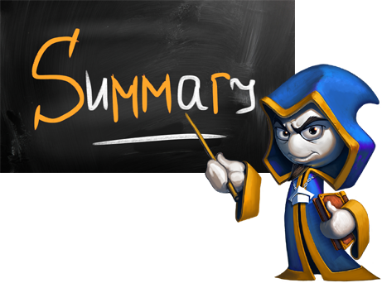
Summary
SQL objects can be accessed directly
EF keeps track of model state
EF Extended lets you bundle update and delete operations
You can change the way EF queries data
With multiple users, concurrency of operations must be observed
Cascade delete is activated by default

Slide 31








EF Advanced Querying
https://softuni.bg/courses/

Slide 32
License
This course (slides, examples, demos, videos, homework, etc.) is licensed under the "Creative Commons Attribution-NonCommercial-ShareAlike 4.0 International" license
Attribution: this work may contain portions from
"Databases" course by Telerik Academy under CC-BY-NC-SA license

Slide 33




Free Trainings @ Software University
Software University Foundation – softuni.org
Software University – High-Quality Education, Profession and Job for Software Developers
softuni.bg
Software University @ Facebook
facebook.com/SoftwareUniversity
Software University Forums
forum.softuni.bg

